Slide 1
Prime Movers
Department of Mechanical and Manufacturing Engineering

Slide 2
Prime Movers
Definition:
A device which produces useful power output is called as a prime mover.
Classification:
1. Electric Motor
2. Engines
External combustion engine. Ex. Steam Engine
Internal Combustion engine
Petrol engine
Diesel engine
3. Turbines
Steam turbine
Gas turbine
Water turbine
Wind turbine
Department of Mechanical and Manufacturing Engineering

Slide 3
STEAM TURBINES
Steam turbine:
It is a device in which heat energy of the high pressure steam is transformed into kinetic energy, and later kinetic energy is transformed into mechanical energy in the form of rotary motion of turbine shaft.
Department of Mechanical and Manufacturing Engineering

Slide 4
Parts of a steam turbine
Nozzles
Rotor
Blades
Shaft
Casing
Department of Mechanical and Manufacturing Engineering

Slide 5
Nozzles:
Nozzles are used to convert pressure energy of the steam into kinetic energy and they direct the steam on to the blades.
Blades:
They are the curved metal plates over which steam is directed.
.Moving blades
They are mounted on the circumference of the turbine rotor.
They convert KE of steam into mechanical work
Fixed blades
They are fixed to the casing. They either guide the flow of steam from one stage to the other or they increase the velocity of steam
Department of Mechanical and Manufacturing Engineering

Slide 6
Rotor:
It is a circular disc on which moving blades are mounted.
Shaft:
It is a metal rod on which rotor is fixed.
Casing:
It is the housing which encloses the entire set up.
Department of Mechanical and Manufacturing Engineering

Slide 7
Classification of Steam Turbines.
Steam turbines are classified into 2 types
a) Impulse Turbine
b) Reaction Turbine
Impulse Turbine:
In this type of turbine, the steam is initially expanded in a nozzle, so that high pressure steam is converted into high velocity steam.
Department of Mechanical and Manufacturing Engineering

Slide 8
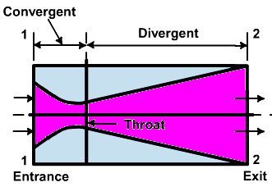
Convergent – Divergent nozzle
Steam out at high velocity& low pressure
Steam in at high pressure
Department of Mechanical and Manufacturing Engineering

Slide 9
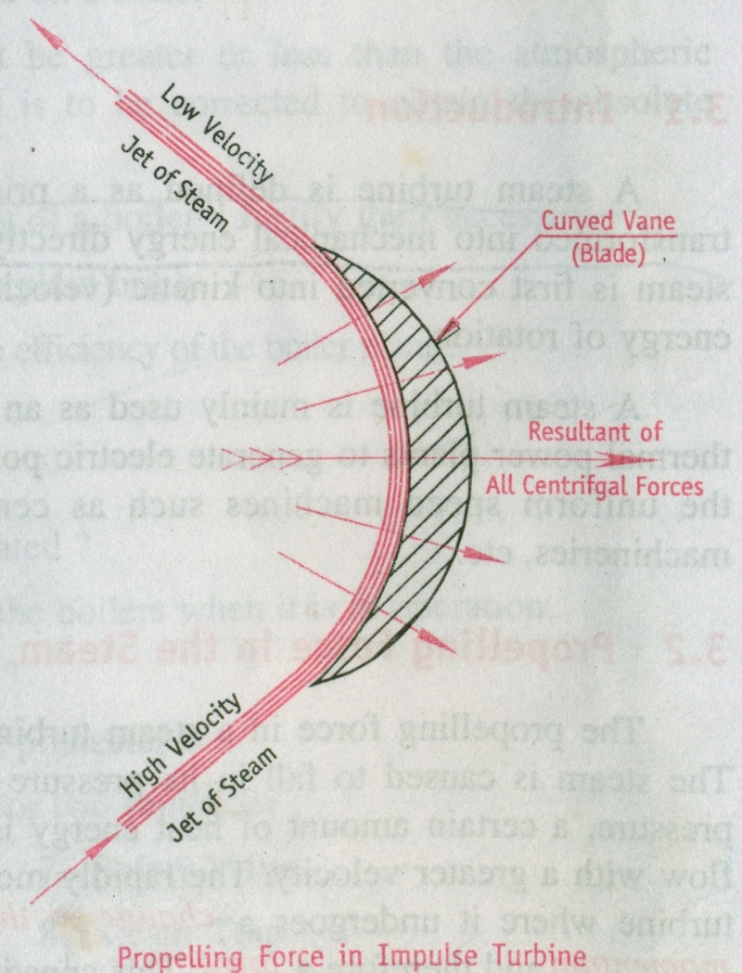
Propelling Force in a Impulse Turbine
Department of Mechanical and Manufacturing Engineering

Slide 10
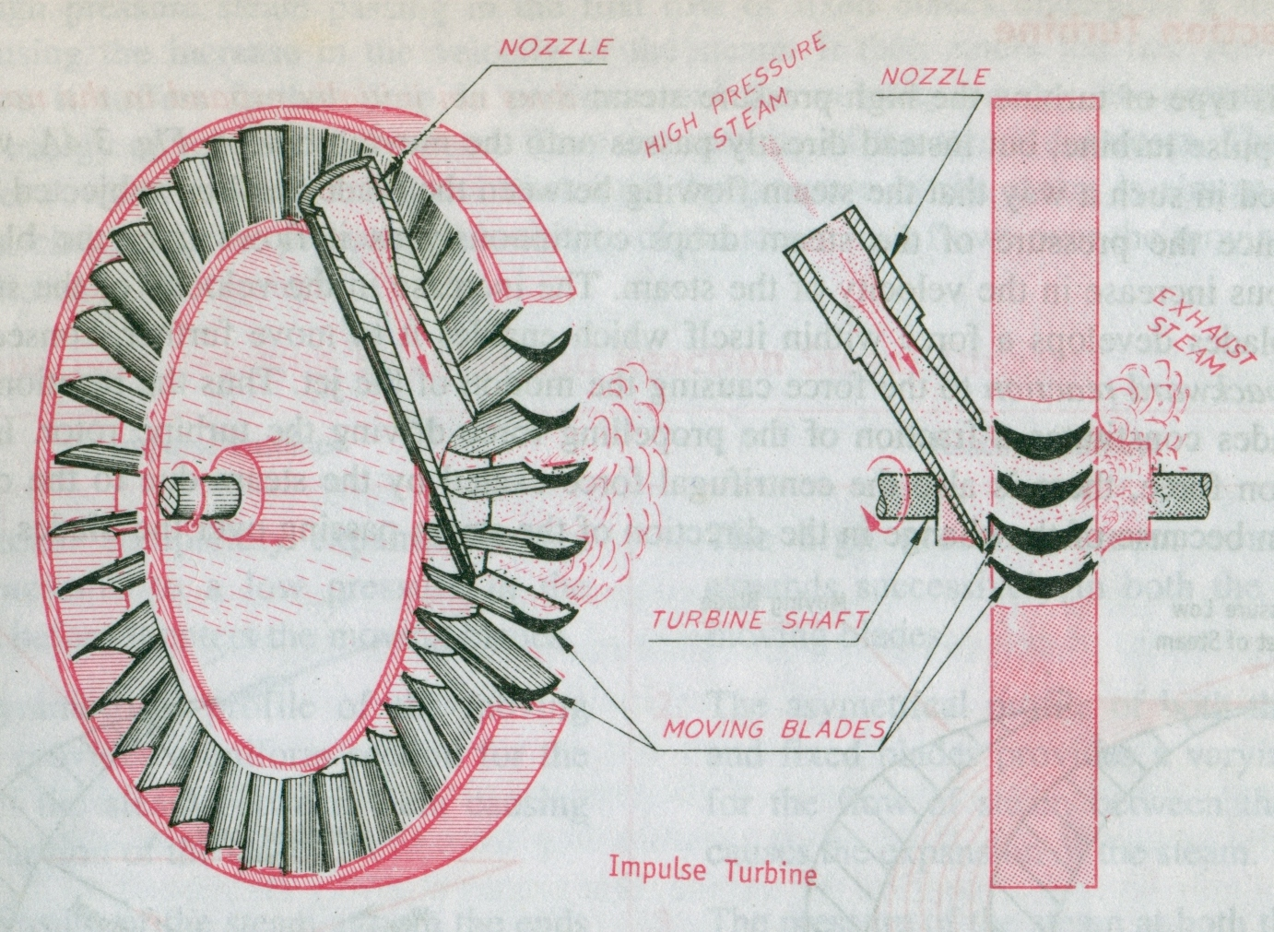
Department of Mechanical and Manufacturing Engineering

Slide 11
The jet of steam coming from the nozzle glides over the blade and gets deflected in a circumferential direction.
This causes the particles of steam to suffer a change in the direction of motion which gives rise to a change of momentum and therefore a force, which will be centrifugal in nature.
The particles of steam exert centrifugal pressures all along their path on the curved surface of the blade.
The resultant of all these centrifugal forces acting on the entire curved surface of the blade causes it to move.
When number of such blades are fitted on the circumference of the rotor they will be moved by the action of the steam jet in succession which in turn sets the rotor in continuous rotation.
Department of Mechanical and Manufacturing Engineering

Slide 12
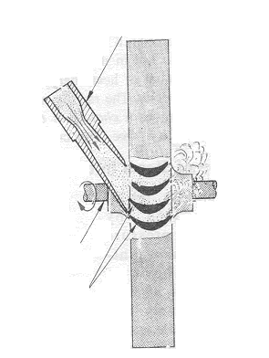

Principle of working.
Pressure-Velocity changes in a Impulse Steam Turbine
HIGH PRESSURE STEAM
NOZZLE
EXHAUST STEAM
TURBINE SHAFT
MOVING BLADES
A
Q
Boiler pressure
R
Velocity
Velocity
Pressure
P
B
C
Department of Mechanical and Manufacturing Engineering

Slide 13
In a impulse turbine since the expansion of the steam takes place in the nozzle, the pressure drop is represented by the curve AB. As there be no change in the pressure of the steam passing over the blades, it is represented by the horizontal line BC.
The velocity of the steam increases in the nozzle due to expansion of the steam and the same is represented by PQ.
As the blades absorb the kinetic energy of the steam as it flows over it, the velocity decreases. This is represented by QR.
Department of Mechanical and Manufacturing Engineering

Slide 14
Need for Compounding:
In an impulse turbine
Pressure energy → Kinetic energy → Mechanical energy
If this complete energy transformation takes place in one stage, then the turbine rotor rotates at very high speeds.
Such a high speed poses a number of technical problems such as increase in vibrations, quick overheating of the bearings, difficulty in lubrication, impossibility of direct coupling to the other machines etc.
Department of Mechanical and Manufacturing Engineering

Slide 15
Need for Compounding:
Therefore expansion of the steam is performed in several stages which is known as compounding.
Hence the purpose of compounding is to utilize the high pressure energy of the steam by expanding it in successive stages so as to reduce the turbine speed. The different methods of compounding are
1. Pressure Compounding.
2. Velocity Compounding.
3. Pressure – Velocity Compounding.
Department of Mechanical and Manufacturing Engineering

Slide 16
Pressure Compounded Impulse Turbine
Department of Mechanical and Manufacturing Engineering

Slide 17
Pressure Compounded Impulse Turbine
Pressure compounded steam turbine comprises alternate rows of fixed nozzles and moving blades arranged in series.
The high pressure steam expands in the nozzles of the first stage with a small pressure drop leading to conversion of a small fraction of pressure energy into kinetic energy.
The steam with this small amount of kinetic energy then enters the moving blades of first stage where it undergoes a change of momentum and gives up all its kinetic energy which is absorbed by the rotating wheel.
Department of Mechanical and Manufacturing Engineering

Slide 18
Pressure Compounded Impulse Turbine
The process continues in the remaining stages until the steam pressure reduces to the exhaust pressure or condenser pressure.
Since the pressure compounded steam turbine facilitates transformation of a small portion of pressure energy into kinetic energy in each stage the steam velocity is much lower which reduces the rotational speed of the turbine.
Department of Mechanical and Manufacturing Engineering

Slide 19
Velocity Compounded Impulse Turbine
Department of Mechanical and Manufacturing Engineering

Slide 20
Velocity Compounded Impulse Turbine
Velocity compounded steam turbine comprise of one set of nozzles and two or more rows of moving blades arranged in series. In between two rows of moving blades one set of fixed blades are suitably arranged which are fitted to the casing and guide the flow of steam from one row of moving blade to the next.
The steam entirely expands in the nozzle from an initial high pressure down to a lower exhaust pressure or condenser pressure.
The high velocity jet of steam flowing out of the nozzle enters the first row of moving blades and gives up only a fraction of its kinetic energy to the wheel and issues out from the first set of moving blades with a fairly high velocity.
Department of Mechanical and Manufacturing Engineering

Slide 21
Velocity Compounded Impulse Turbine
It then enters the first row of fixed blades which redirects them to the second row of moving blades. As it passes over second row of moving blades it undergoes change in momentum for the second time and gives up that fraction of its kinetic energy to the wheel.
If required the process continues in the remaining stages where it gives up the remaining kinetic energy and finally leaves the last row of moving blades with little residual velocity.
Since in this type of turbine kinetic energy is absorbed by different rows of moving blades, the speed of the wheel will be relatively less as compared to the turbine having only one row of moving blades.
Department of Mechanical and Manufacturing Engineering

Slide 22
Department of Mechanical and Manufacturing Engineering

Slide 23
Pressure-Velocity Compounded Impulse Turbine
Department of Mechanical and Manufacturing Engineering

Slide 24
Pressure-Velocity Compounded Impulse Turbine
This type of compounding is a combination of pressure compounding and velocity compounding.
Here the pressure drop is split into two or more stages and the kinetic energy gained in each step is also absorbed in stages.
In a two stage pressure velocity compounded turbine the first pressure drop occurs in the first set of nozzles and the resulting gain in kinetic energy is absorbed successively in two rows of moving blades before the second pressure drop occurs in the second set of nozzles.
The kinetic energy gained due to the second pressure drop in the second set of nozzles is absorbed successively in the next two rows of moving blades.
The row of fixed blades in between, guides the flow of steam from one row of moving blades to the next.
Department of Mechanical and Manufacturing Engineering

Slide 25
Reaction steam Turbine
In this type of turbine the high pressure steam does not initially expand in the nozzle as in the case of impulse turbine, but instead directly passes onto a set of fixed and moving blades.
Two types of blades are used in the reaction turbine, Fixed blades and Moving blades. Fixed blades are fitted to the casing and the Moving blades to the rotor
The expansion of the steam takes place both in the fixed and the moving blades.
Department of Mechanical and Manufacturing Engineering

Slide 26
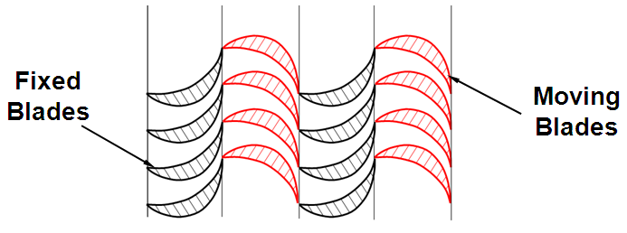
Reaction Turbines
The fixed blade ring between the two moving blade rotors not only increases the velocity of the steam but also guides the steam to enter from one row of moving blades to the next.
Department of Mechanical and Manufacturing Engineering

Slide 27
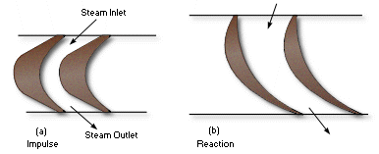
Blade profile comparison
Department of Mechanical and Manufacturing Engineering

Slide 28
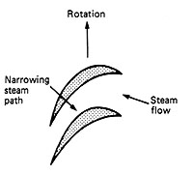
Fixed blade
High Pr. low velocity jet of steam
Low Pr. high velocity jet of steam
Department of Mechanical and Manufacturing Engineering

Slide 29
Moving Blade
High Pr. high velocity jet of steam
Low Pr. low velocity jet of steam
Department of Mechanical and Manufacturing Engineering

Slide 30
Pressure of the steam drops continuously as it flows over the both the blades, simultaneously velocity of the steam increases while passing over fixed blades and decreases while passing over the moving blades.
When the steam flows over the moving blades there will be a backward reaction force acting on the blades. This reaction force acting on the blades constitutes a portion of the propelling force driving the turbine rotor.
In addition to this reaction force, there is also a centrifugal force exerted by the steam due to the change of the momentum because the change in the direction of the steam passing over the blades. This reduces the velocity of the steam.
Thus the net force acting on the moving blades of a reaction turbine is the vector sum of the centrifugal and the reaction forces.
.
Department of Mechanical and Manufacturing Engineering

Slide 31
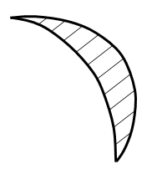
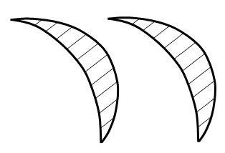
Propelling force in a Reaction Turbine
Resultant force
Reaction force
Centrifugal force
Department of Mechanical and Manufacturing Engineering

Slide 32
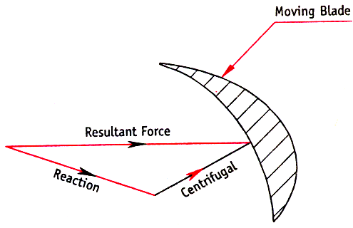
Force diagram
Resultant force
Reaction force
Centrifugal force
Department of Mechanical and Manufacturing Engineering

Slide 33
Force Analysis
Reaction force:
This force is due to the backward reaction to the force causing the motion of the jet.
Centrifugal force:
This is the force exerted by the steam due to the change in momentum because of the change in direction of the steam while passing over the blades.
Resultant force:
This is the vector sum of Reaction force and Centrifugal force.
Department of Mechanical and Manufacturing Engineering

Slide 34
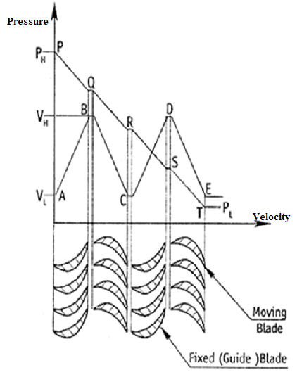
Pressure-Velocity Changes in a Reaction Turbine
The high pressure steam passing in the first row of fixed blades undergoes a small drop in pressure causing the increase in the velocity of the steam. It then enters the first row of moving blades where it suffers further drop in pressure and the velocity energy is converted into the mechanical energy of rotation of the rotor
Department of Mechanical and Manufacturing Engineering

Slide 35
Unlike the impulse turbine, no nozzles are mounted in a reaction turbine. It consists of number of alternate rows of fixed and moving blades.
The high pressure steam passing over the first row of fixed blades undergoes a drop in pressure causing the velocity of the steam to increase.
It them enters the first row of moving blades where it undergoes a further drop in pressure and velocity energy (Kinetic Energy) is converted into mechanical energy causing the velocity of the steam to decrease.
This process continues in the further rows of fixed and moving blades till the pressure of the steam is almost completely reduced.
Department of Mechanical and Manufacturing Engineering

Slide 36
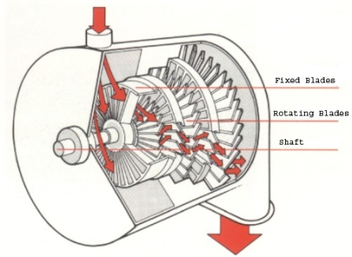
Department of Mechanical and Manufacturing Engineering

Slide 37
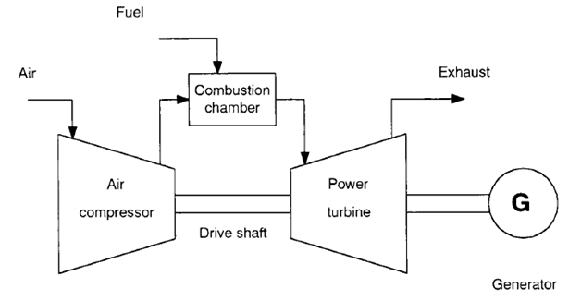
Gas Turbine
The gas turbine cycle comprises three main components: a compressor, a combustion chamber and a turbine.
Air from the atmosphere is compressed in the compressor and then goes to the combustion chamber where the combustion of the fuel takes place.
The resulting hot gases expand in the turbine to perform work. Part of the power produced in the turbine is used to run the compressor and the rest is available to run the generator.
Department of Mechanical and Manufacturing Engineering

Slide 38
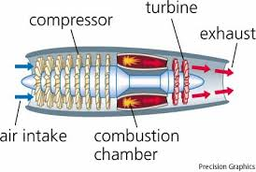
Gas Turbine
Department of Mechanical and Manufacturing Engineering

Slide 39
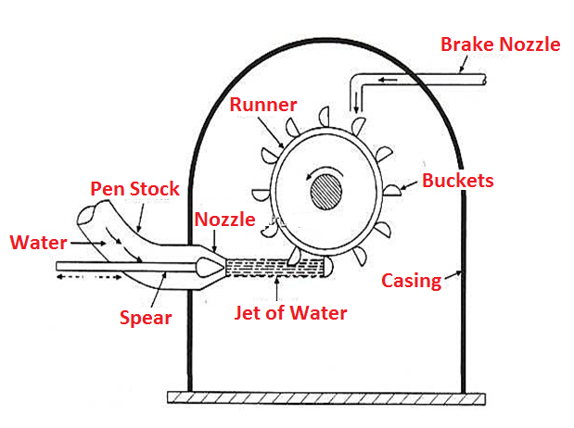
Water Turbine (Pelton Wheel)
Department of Mechanical and Manufacturing Engineering

Slide 40
Water Turbine (Pelton Wheel)
Pelton wheel is an impulse turbine used in high head hydro electric plants having a water head above 300m. (Water Head =Water level difference between the head race and tail race). Surface level of water in the dam is called head race and surface level of water at the exit of the turbine is called tail race.
The water from the reservoir is supplied to the nozzle through huge penstocks wherein the total head of the incoming water is converted in to a large velocity head(kinetic energy)at the exit of the supply nozzle.
The rotor/runner consists of a large circular disc or wheel having a number of spoon shaped buckets spaced uniformly on the periphery.
High velocity jet of water from the nozzle hits these buckets and generates an impulse force which rotates the runner.
Department of Mechanical and Manufacturing Engineering

Slide 41
Water Turbine (Pelton Wheel)
The runner is mounted on a shaft which is connected to a generator.
A spear is provided inside the nozzle to vary the flow rate of water hitting the buckets thereby controlling the power output according to the load demand.
A brake nozzle is used to stop the rotor in emergency situations.
Department of Mechanical and Manufacturing Engineering

